Slide 1



Car Prices in Serbia
Ben Wang, Rebecca Han, Nilson Gao, Vedat Goktepe

Slide 2
1
2
3
4
5
6
Background
Data Analysis
Models
Diagnostics
Validation
Conclusion

Slide 3

1
Background
Taking a dataset from 2024, we want to investigate what factors have the biggest effect on car prices in Serbia?
Is it age?
Maybe car mileage?
Why does it matter?
Knowledge about what contributes to car price can be beneficial knowledge for consumers, dealerships, car companies, manufacturers, etc.
Image Credit: am-online.com

Slide 4
1
2
3
4
5
6
Background
Data Analysis
Models
Diagnostics
Validation
Conclusion

Slide 5
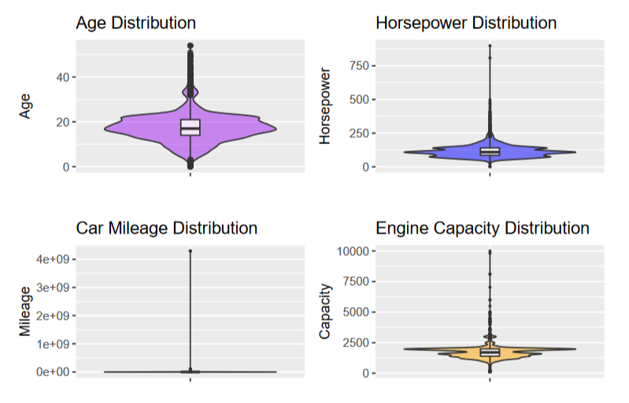
2
Data Analysis
Quantitative Variables: Distribution
Something looks off here!
This is likely a problem
with outliers.
Notes:
To begin our analysis, we wanted to check on which variables have a strong influence on Price. First, we generated violin plots for the continuous variables, but then found that there were some suspicious outputs. This led us to believe that we should clean out some outliers or blanks in the data, as they were making the data difficult to interpret.

Slide 6
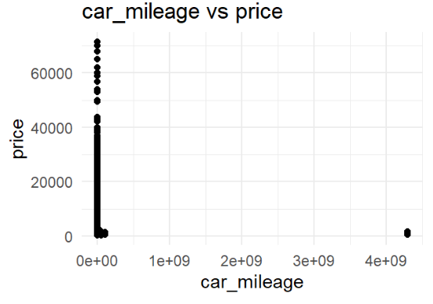
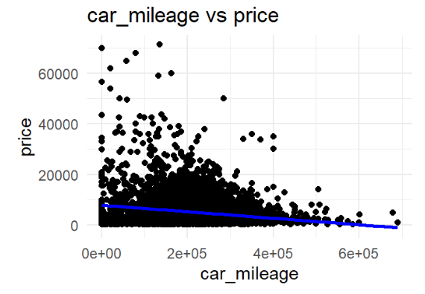
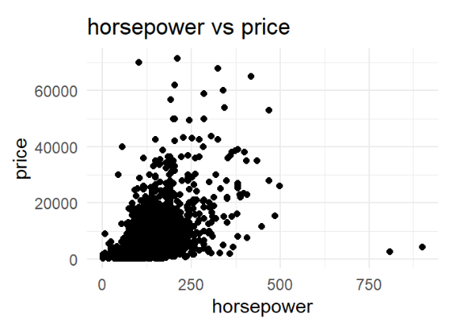
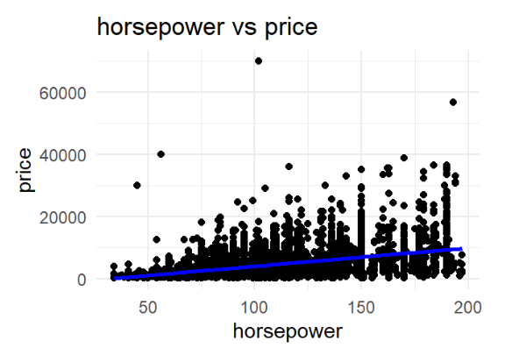
2
Data Analysis
Outlier Removal: Before vs. After
Notes:
To do this, we omitted all rows with any blanks from the dataset, but found that emission_class had a significantly higher number of blanks than the others, so we decided to hold onto those for validation later. To clean outliers, we found and removed outliers on the X-axis and Y-axis, as well as any influential points. As you can see, the resulting graphs were much more readable

Slide 7
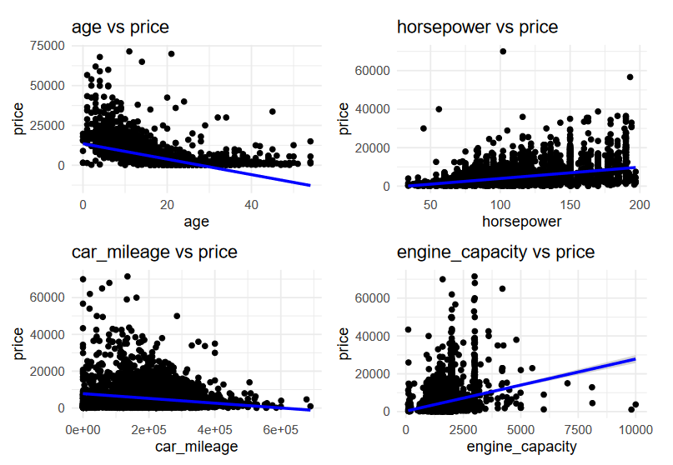
2
Data Analysis
Quantitative Variables: Effect (All other factors constant)
What do these mean?
Price decreases with age
Price increases with HP
Price decrease with mileage
Price increases with engine capacity
So far so good! Similar to what we expect from real life knowledge.
Notes:
Now we can clearly see that price tends to decrease as age or mileage increases, and price tends to increase as horsepower or engine capacity increases. This gave us a lot of confidence in our dataset, since this is about what we logically expected to happen based on prior knowledge of how car pricing works.

Slide 8
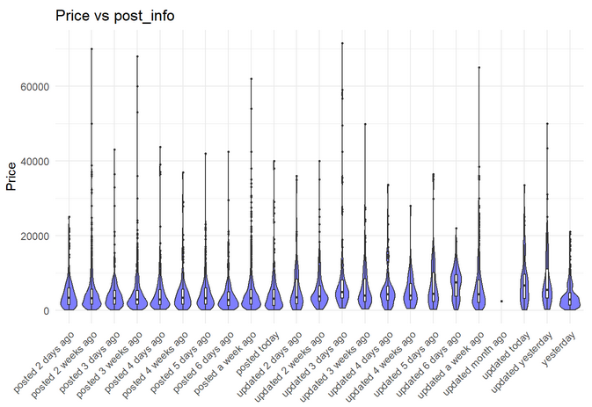
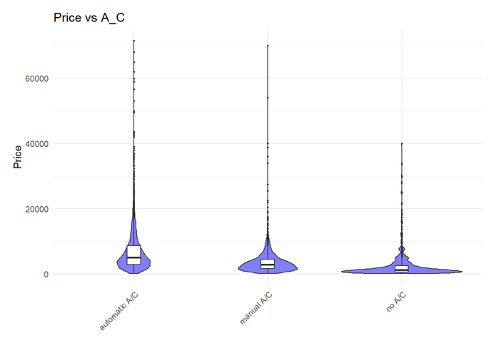
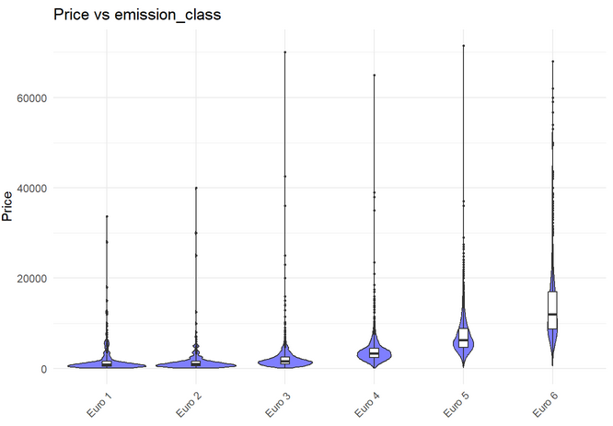
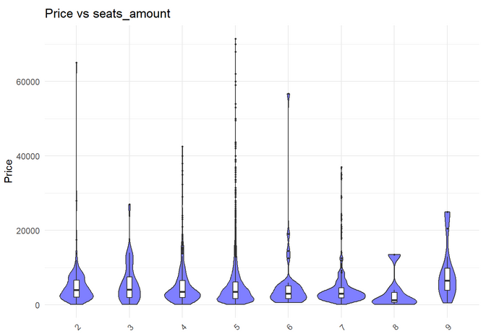
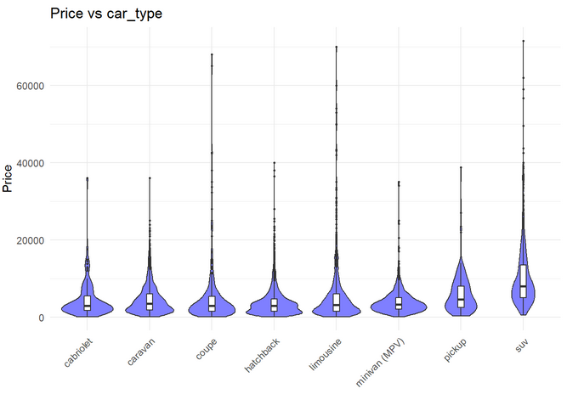
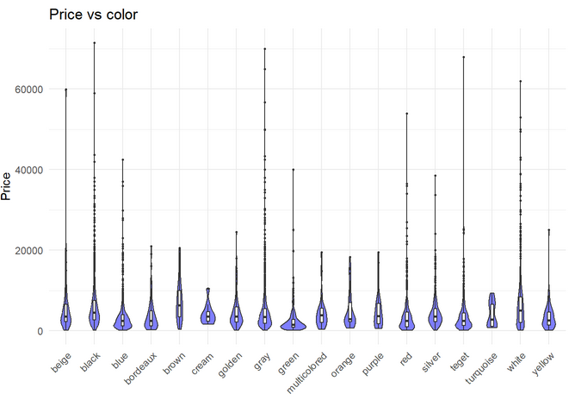
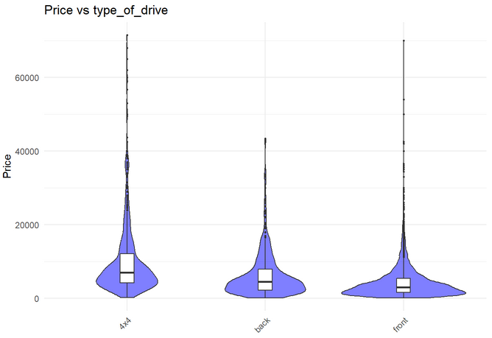
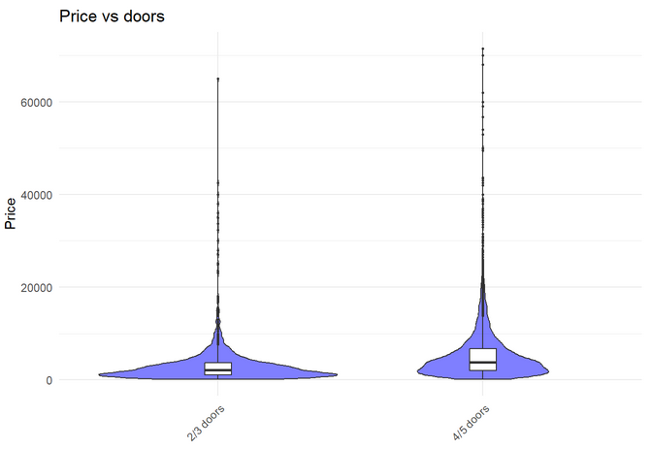
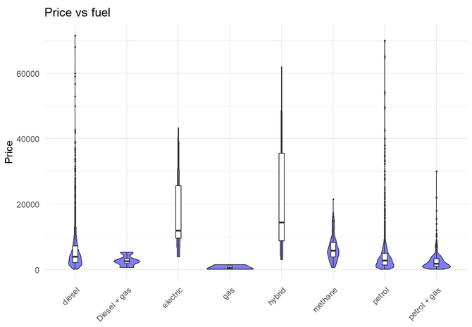
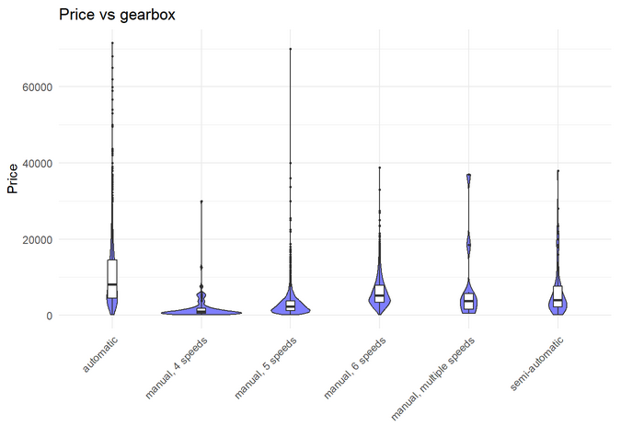
2
Data Analysis
Qualitative Variables: Effect (All other variables held constant)
Notes:
We also generated these graphs to see if our qualitative variables have a significant influence on car price.

Slide 9
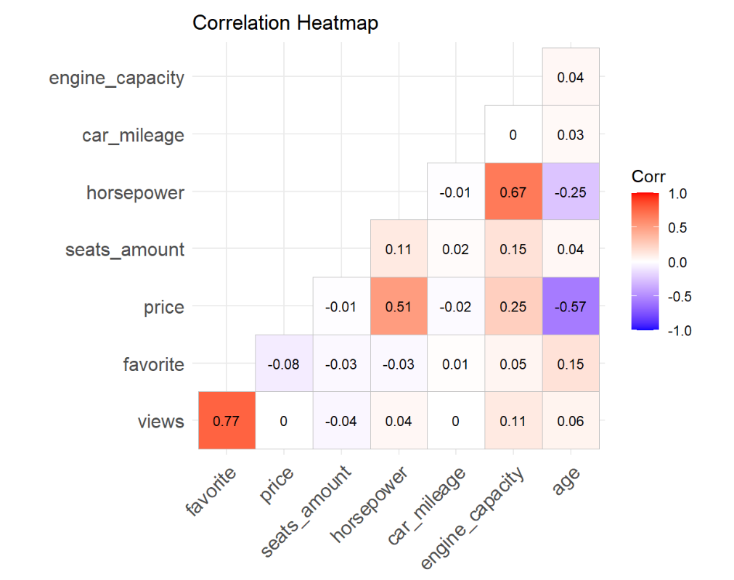
2
Data Analysis
Correlation Heatmap
We want to check for multicollinearity
Horsepower and engine_capacity looks suspicious…
Horsepower and Age seems like strong predictors!
Notes:
In order to check that our variables so far are valid, we checked for the correlation between them. As we can see, there might be some multicollinearity between horsepower and engine capacity, so we have to be careful of that.

Slide 10
1
2
3
4
5
6
Background
Data Analysis
Models
Diagnostics
Validation
Conclusion

Slide 11
3
Models
Main Effect Model: Backward Elimination – Model Based AIC
Removed least effective variables with 5 Backward Elimination steps
Full Model:
views, favorite, car_name, age, A/C, emission_class, seats_amount, horsepower, color, car_milage, engine_capacity, type_of_drive, doors, fuel, car_type, gearbox
Reduced Model:
age, A/C, seats_amount, horsepower, color, car_milage, engine_capacity, type_of_drive, doors, fuel, gearbox

Slide 12

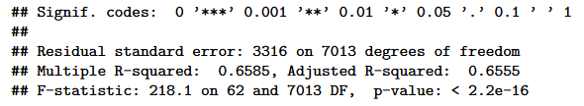
3
Models
Summary of Main Effect Model
This R-squared value means that this model explains ~66% of variability in Price
Notes:
hi

Slide 13


3
Models
Summary of Interaction Model
We added interactions of age, mileage, engine_capacity, and horsepower with all categorical variables
Backward Elimination – Model Based AIC
This R-squared value means that this model explains ~ 74% of variability in Price
This is higher, which is a good indicator that we improved the model by adding interaction terms!

Slide 14
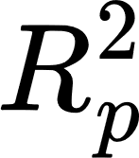
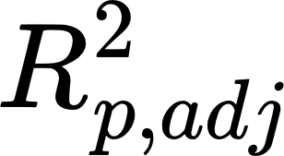

3
Models
Model Comparison
Main Effect Model
0.6585
0.6555
2236.38
Interaction Model
0.7522
0.743
2228.41
adj

Slide 15

1
2
3
4
5
6
Background
Data Analysis
Models
Diagnostics
Validation
Conclusion

Slide 16
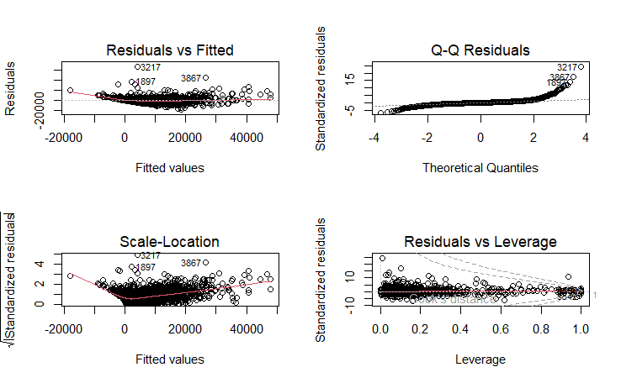
4
Diagnostics
Plotting the residuals of our interaction model, we have:
The residual plot looks quadratic
It looks like the Normality assumption may be violated

Slide 17



4
Diagnostics
Summary of Interaction Model w/ Box-Cox Transformation
We added interactions of age, mileage, engine_capacity, and horsepower with all categorical variables
Backward Elimination – Model Based AIC
This R-squared value means that this model explains ~ 87% of variability in Price
This is higher, which is a good indicator that we improved the model by performing the transformation!

Slide 18
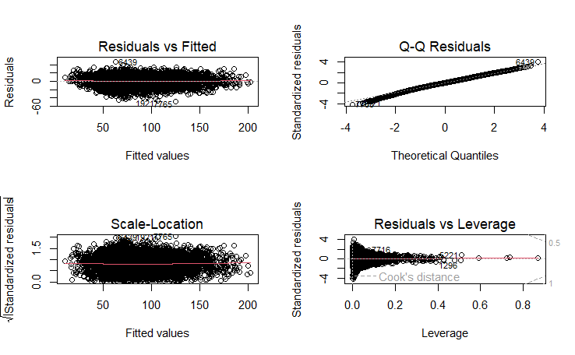
4
Diagnostics
Earlier, we used Cook’s Distance to delete anomalous data
Now, we’re also performing a Box-Cox transformation to help our model meet the Normality assumption
These plots look much better (in terms of meeting LINE assumptions)

Slide 19
1
2
3
4
5
6
Background
Data Analysis
Models
Diagnostics
Validation
Conclusion

Slide 20

5
Model Validation
We used hold-out validation on our data:
Trained 6652/7988 (83.3%) of the data
Tested on 1336/7988 (16.7%) of the data
The standard error of the data:
Standard Error of Training Data: ~3
This is expected, since it should almost perfectly align with what we have in training data (except for errors caused by lack of emission_class)
Standard Error of Testing Data: ~6,655
Means that our prediction is only about $6655 off of the actual price on average (not accounting for errors caused by lack of emission_class), meaning that it’s fairly accurate

Slide 21
1
2
3
4
5
6
Background
Data Analysis
Models
Diagnostics
Validation
Conclusion

Slide 22
6
Conclusion
The most influential factors:
Age
Horsepower
Car Mileage
Engine Capacity
We are missing a lot of factors. Various visual or mechanical problems of the car might have a big influence and is missing from our data.

Slide 23
THANKS FOR LISTENING

Slide 24
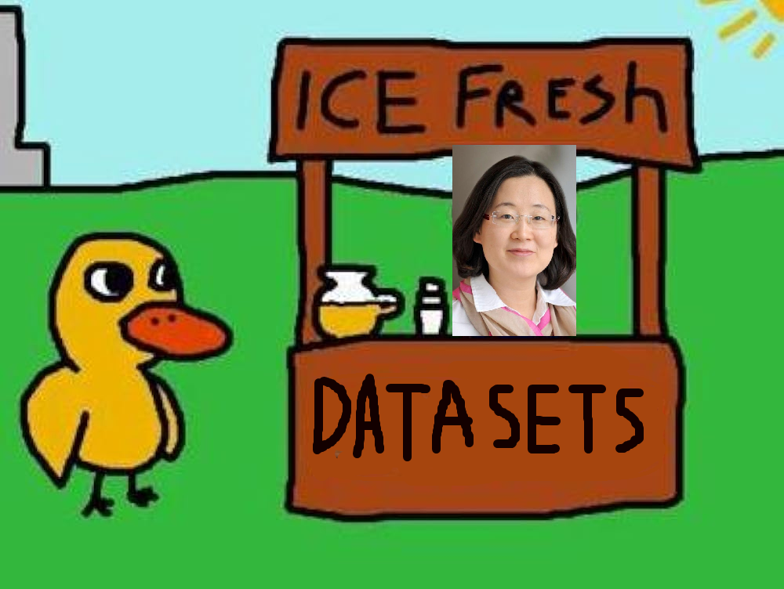

Song Lyrics
A group walked up to the stats stand, And they said to Sohee, running the stand Hey, (bum bum bum), got any models?
Sohee said “No I just sell datasets, But it’s clean, no-NAs, and it’s very fresh Would you like a graph?” They said “I guess”
And they modeled away, model model, And they modeled away, model model, And they modeled away, model model, Till the project due date

